Slide 1

I Do Not Know What You Visited Last Summer: Protecting users from stateful third-party web tracking with TrackingFree browser
Xiang Pan§, Yinzhi Cao†, Yan Chen§
Presenter: Fan Luo
College of William and Mary

Slide 2
Roadmap
Introduction
Previous work & Novelty
System Design
Evaluation
Summary

Slide 3


Web Tracking
Record the client’s behavior
  Identifier
  Private information
  Prevalent
    - More than 90% of Alexa Top 500 web sites [Roesner, NSDI 2012]
    - A web page usually has multiple tracking elements
Notes:
stateful (“supercookie”) and stateless (“fingerprinting”) technologies that can be used to pseudonymously correlate web activities.

Slide 4


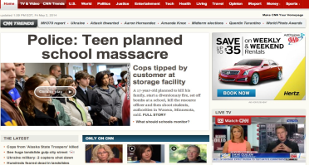

Research problem
Protecting users from stateful third-party web tracking
First party: host web server
Second party: user
Third party: tracking we server
Referer : http://online.wsj.com/
Cookie : id = 12345
Tracker
User
Referer : http://www.cnn.com/
Cookie : id = 12345
visit
visit

Slide 5
Goals
• Complete blocking
• High function preservation
• Low performance overhead

Slide 6
Out-of-scope Goals
Doesn’t address following threats:
  Within-Site Tracking
  Tracking by exploiting browser vulnerabilities
  Stateless tracking

Slide 7
Roadmap
Introduction
Previous work & Novelty
System Design
Evaluation
Summary

Slide 8
Previous Work
Disable third-party identifiers
  Can be easily bypassed
Blacklist third-party requests
  Priori knowledge of tracking server
Do-not-track header
  No enforcement
No effective defense approach
8
Notes:
Existing works either disable setting tracking identifiers or
blacklist thirdparty requests to certain servers.
However, neither of them can completely block stateful web tracking.

Slide 9
Novelty
TrackingFree：
First anti-tracking browser by mitigating unique identifiers.
Main idea:
    Partition client-side states into multiple isolation units
    Identifiers still exist but are not unique
    Cut off the tracking chain
Notes:
first allocates initial server-side contents based on the registered domain names, and then allocates derivative server-side contents, such as user-navigated windows/frames and pop-up windows, based on a dynamically generated in-degree-bounded graph with its nodes as browser principals

Slide 10
Roadmap
Introduction
Previous work & Novelty
System Design
Evaluation
Summary

Slide 11
System Design
Profile based isolation mechanism
Principal Communication
Content allocation mechanism
Flexibility of domain specification
Notes:
The Do Not Track (DNT) header is the proposed HTTP header field. No enformence
2015/9/16
11

Slide 12
Content allocation mechanism
Initial Contents Allocation
  Top frame: navigated by users directly
Derivative Contents Allocation
  Child frame: frames generated due to the contents on other frames

Slide 13
Initial Contents Allocation
Granularity （→）
  All the subdomains of a registered domain will be grouped together.
  Different domains are put in different principals.
One Principal per Domain (←)
  For the web pages opened through address bar and
  command line arguments, they will be put in one principal
  if and only if they have the same domain.

Slide 14
Derivative Contents Allocation
Principal Switch
  Should we switch principle for child frame?
Principal Selection
  How to choose target principal?
Notes:
First, TrackingFree needs to decide whether those child frames stay in the same principal as the main frame.
A short answer is that TrackingFree keeps all non-user-triggered frames in the principals that a main frame belongs to, and moves all user-triggered
frames to other principals. This process is defined as principal switch

Slide 15
Principal Switch
Two intuitive yet extreme switch algorithm:
  No switch : privacy issue
  Switch all : unnecessary overhead
Solution: switch if and only if both of the following conditions are met
  Cross-site
  Main frame navigation OR User-triggered
Notes:
Now a key question is how to dynamically monitor trackingfree? Dynamic programming analysis will involve in too much overhead. So we take an conservative approximated approach: hooks up all the click events in any frames and once an event is triggered, it will label the frame on which the event is happening as user-activated frame, when a child frame gets changed or created, we will determine whether it’s user triggered by checking if its source frame is user-activated frame. This can involves false positive, that is, labeling a non-user trigger frame as user-triggered frame, but the privacy-preserving capability has not been compromised.

Slide 16
Principal Selection
Two intuitive yet extreme selection algorithm:
  Always create new principal : compatibility issues
  Always reuse existing principal: privacy issue
Solution: in-degree-bounded principal selection policy
  Maintain a graph of all the principals
  Maximum in-degree number = 2
Notes:
Selection only if switch is going to happen
Now we know when to switch principal, the next thing we would like to know is if a switch is required, Which principal to use? Create a new one or reuse the existing one?

Slide 17
Graph of Principals
Node ： principal
Edge ：at least one frame has switched
Notes:
Each node represents a principal and the edge between two node means at least one frame has switched from start the node to the end node.

Slide 18
Principal Communication
Two intuitive yet extreme communicational algorithm :
  Unconditional enable : privacy issue
  Completely disable : functionality issue
Solution: adopt different policies for different channel
Explicit communication :
messaging among different frames by browser APIs
  Implicit communication :
  history sharing, communication through navigation
Notes:
Unconstrained enable: can be abused by tackers to bypass principal boundaries,
thus leak out user’s private information.
Completely disable: severely breaks the functionalities of existing web services
Explicit communication refers to the message channels that allow cross-origin messaging among different frames through browser APIs.
Obviously, explicit communication can break the isolation mechanism

Slide 19
Explicit communication
Problem : break the isolation mechanism
Solution: use following restrictive conditions
  Third-party elements can only explicitly communicate with the first-party elements in its principals.
  First-party elements can only explicitly communicate with the first-party elements placed in its neighbor principals
Notes:
That means Third-party elements can not explicitly communicate with other principals

Slide 20
Example

Slide 21
Implicit Communication
  History Sharing
    Why? Browsing history is isolated
    How? Public history manager
    Secure? Principle can only write, can not read
  Communication through navigation
    Problem : tracker can put tracking identifier on cross-site URLs
    Compromised solution : Clear the query strings on non-navigation third party requests’ refer headers
Notes:
Do not restrict implicit communication because of derivative contents allocation policy

Slide 22
Preference Configure
Problem：
  User preference is isolated, causing user experience issues
Solution:
  Apply user-initiated changes in each principal to all existing principals.
  Monitor GUI message to determine user-initiated preference change.
  Synchronize with new created principal
Notes:
Isolation is good, otherwise can be abused to store tracking identifier.

Slide 23
Domain Data Manager
Domain Data Manager
why? Decrease the number of principals
how? Transient principal for each regular principal
Domain Data Synchronization
why? Improve user experience
how? Synchronize data belonging to specified domains

Slide 24
Roadmap
Introduction
Previous work & Novelty
System Design
Evaluation
Summary

Slide 25
Evaluation
Anti-tracking capability
    Formal proof
    Experiments with real world websites
Performance
    Overhead (latency, memory, disk)
Compatibility

Slide 26
Formal Proof
Formally analyze TrackingFree ’s anti-tracking ability:
  give alloy an assertion
  alloy try to search the space to find the counter example
Formally verified : without site collaboration, trackers can correlate user’s activities up to three principals.
Notes:
Alloy is the most popular formal proof system
Here is how the proof works. We give alloy an assertion, which is the goal we want to prove. Like TrackingFree can protect user’ privacy and give a space size. Like 15 httprequests. Then alloy will try to search the space to find the counter example that controvert the goal. If it find one, The goal deosn’t hold. A good thing of Alloy is that it can completely search the space, that is, if alloy says no conterexamples in this space, than there is no conterexample.

Slide 27
Experiments with Real World Web Sites
Visit 2,032 valid URLs from Alexa Top 500 web sites
Gathered 647 tracking tokens
TrackingFree eliminated all of them

Slide 28
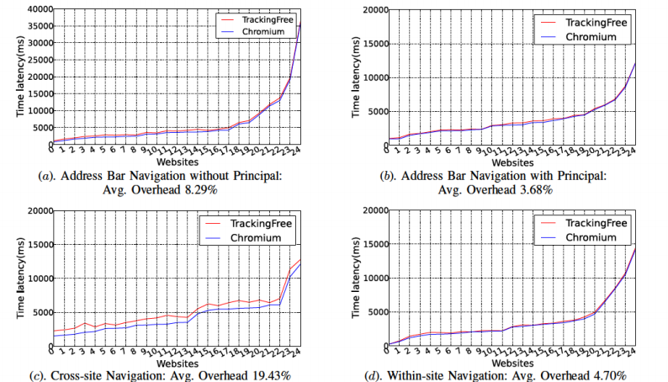
Performance: Latency

Slide 29
Performance: Memory & Disk overhead
Memory Overhead on 12 Web Pages (~25MB/Principal)
Memory | Chromium | TrackingFree | Increase
1 Principal | 477.1(MB) | 505(MB) | 27.9(MB)
4 Principals | 623.6(MB) | 702.8(MB) | 79.2(MB)
12 Principals | 434.6(MB) | 642.5(MB) | 297.9(MB)
Disk Overhead on 12 Web Pages (~0.6MB/Principal)
Memory | Chromium | TrackingFree | Increase
1 Principal | 21.3(MB) | 21.8(MB) | 0.5(MB)
4 Principals | 22.5(MB) | 25.9MB) | 3.4(MB)
12 Principals | 23.7(MB) | 29.4(MB) | 5.7(MB)

Slide 30
Compatibility
Teste on Alexa Top 50 websites
Compatibility on first-party websites : 50/50
Compatibility on third-party services
  - Cross-site online payments (1/1)
  - Cross-site content sharing (31/31)
  - Single sign-on (35/36)
  - Overall results: 67/68

Slide 31
Roadmap
Introduction
Previous work & Novelty
System Design
Evaluation
Summary

Slide 32
Summary
Research Problem:
Protecting users from stateful third-party web tracking
Solution:
Isolating resources in different principals.
Designed and implemented TrackingFree browser
Evaluation:
Theoretically and experimentally proved anti-tracking capability
Affordable overhead and compatibility cost.

Slide 33
Questions
  1. Why utilize profile based isolation mechanism to isolate different principals?
2. For principal selection, why the maximum in-degree number is set to be 2 ?
3. What are the two methods for dealing with the inconsistency of multiple
principals for a single site?

